Slide 1
Common CMD Commands
help
cd DIRNAME
cd ..
pwd
dir ( ls )
copy FILENAME NEWLOCATION ( cp )
move FILENAME NEWLOCATION ( mv )
exit
<Tab> - fills in the rest of a partial file name

Slide 2
Try This
First, you must ensure that the JDK is part of your system path.
echo $PATH
Then, the javadoc program will be accessible.
javadoc

Slide 3
JavaDocs – A Better Way
/* Regular block comments */
// Single line comments
/** JavaDoc comments! **/

Slide 4
A small set of JavaDoc tags
For classes:
@author
@version
For methods:
@return
@param
@pre
@post

Slide 5
JavaDoc CMD Arguments
javadoc [options] [packages] [source files]
Options
  -author = look for the @author tag
  -version = look for the @version tag
  -classpath <list of jars> = scan these jars for unknown classes
  -d <dir name> = put the resulting javadoc htmls in this folder
  -sourcepath <dir with .javas> = use this dir as the project directory
  - tag <tag definition> = define a custom javadoc tag

Slide 6
Generating JavaDocs
Step 1: Add Tags to source code. Tags must be exactly above the feature they describe.
/**
* Determine a birth year given an age
*
* @param age how old a person is in standard Earth years.
* @pre 0 < age < 2000
* @return int the year the person was born
*/
public int findYear(int age) {}

Slide 7
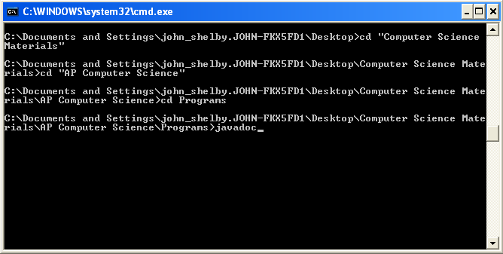
Generating JavaDocs
Step 2: Navigate to your project directory using cmd commands. Check that your PATH is set correctly by doing a test javadoc run.

Slide 8
Generating JavaDocs
Step 3: Run javadoc using arguments that describe exactly what you want for your output.
A realistic javadoc execution:
javadoc -author -version -tag pre:cm:"Precondition:" -tag post:cm:"Postcondition:" -d doc -classpath ./lib/* -sourcepath ./src ./src/*

Slide 9
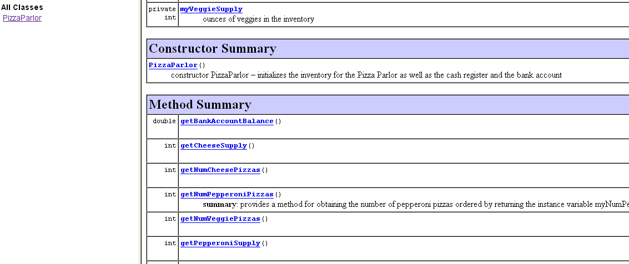
Generating JavaDocs
Step 4: Check your new JavaDocs to see if they look good! Do this by opening index.html in the docs directory.

Slide 10
Preconditions
Precondition: Requirement that the caller of a method must meet
Publish preconditions so the caller won't call methods with bad parameters
/**
Deposits money into this account.
@param amount the amount of money to deposit
@pre amount >= 0
*/
public void deposit(int amount)

Slide 11
Preconditions
Typical use:
  To restrict the parameters of a method
  To require that a method is only called when the object is in an appropriate state
If precondition is violated, method is not responsible for computing the correct result. It is free to do anything.

Slide 12
Preconditions
Method may throw exception if precondition violated
Method doesn't have to test for precondition. (Test may be costly)
if (amount < 0) throw new IllegalArgumentException();
balance = balance + amount;
// if this makes the balance negative, it's the caller's fault
balance = balance + amount;

Slide 13
Preconditions
Many beginning programmers silently return to the caller
if (amount < 0) return; // Not recommended; hard to debug
balance = balance + amount;

Slide 14
Postconditions
Postcondition: Condition that is true after a method has completed
Contract - If caller fulfills preconditions, method must fulfill postcondition
There are three kinds of postconditions:
  The return value is computed correctly (usually handled by @return tag)
  The implicit parameter is in a certain state after the method call is completed
  An explicit parameter is modified (side effect)

Slide 15
Postconditions
Formulate pre- and postconditions only in terms of the interface of the class
/**
Deposits money into this account.
@param amount the amount of money to deposit
@pre amount >= 0
@post getBalance() >= 0
*/
public void deposit(int amount)
@post balance >= 0
// wrong postcondition formulation – ‘balance’ is
// private and invisible outside of the class

Slide 16
Shapes
For each of your Shapes classes…
  Line, Rectangle, Circle
…you must have JavaDoc comments for all public features…
  The class itself
  Methods
…that utilize appropriate tags.
  For the class: author, version
  For methods: param, return, pre, post

Slide 17
Turning in the Shapes
YOUR_NAME.zip
    /Shapes
    /src
      Line.java, Rectangle.java, Circle.java
      /lib
      core.jar
      /doc
      [all javadoc generated html and subdirectories]
      (other Eclipse project files)

